Slide 1

Project no. 108
Minor Project-II
18B19CI591
Panel no. 7
Project Guide : Dr. Ajay Kumar
Dr. P.S. Banerjee
Dr. Rahul Pachauri

Slide 2
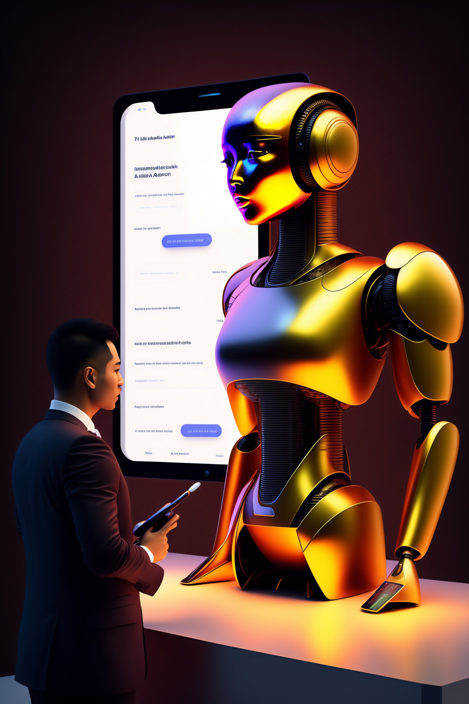
MyFAANG

Slide 3

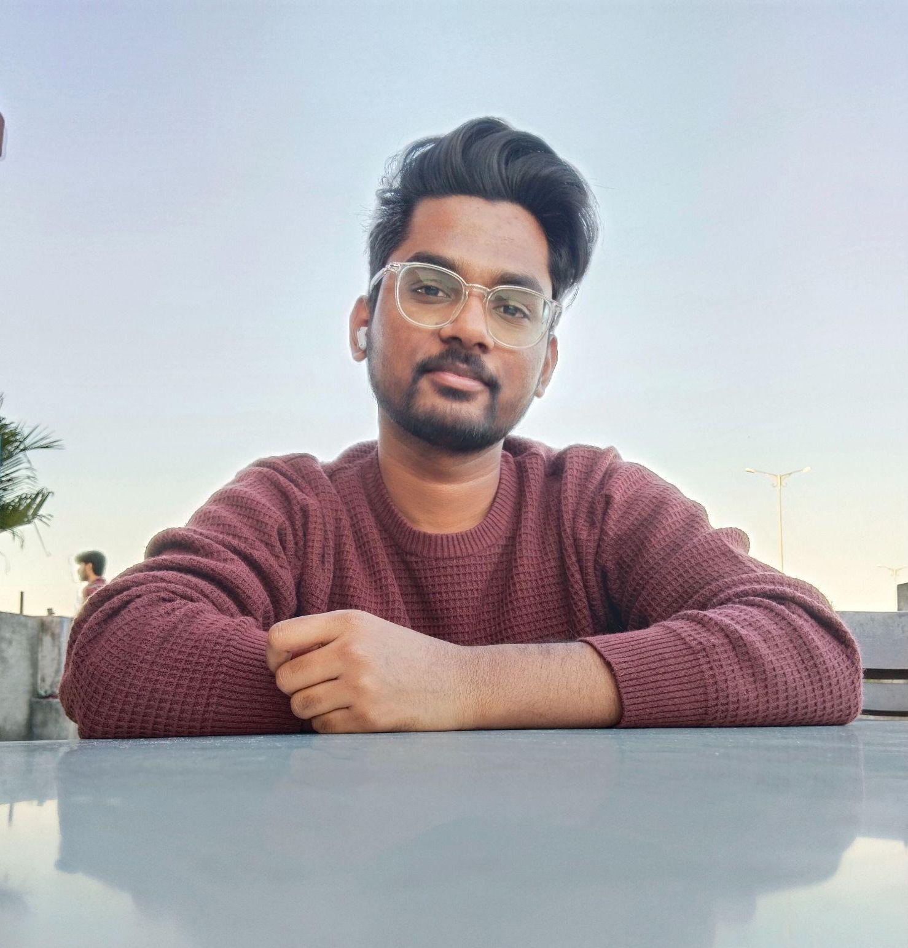
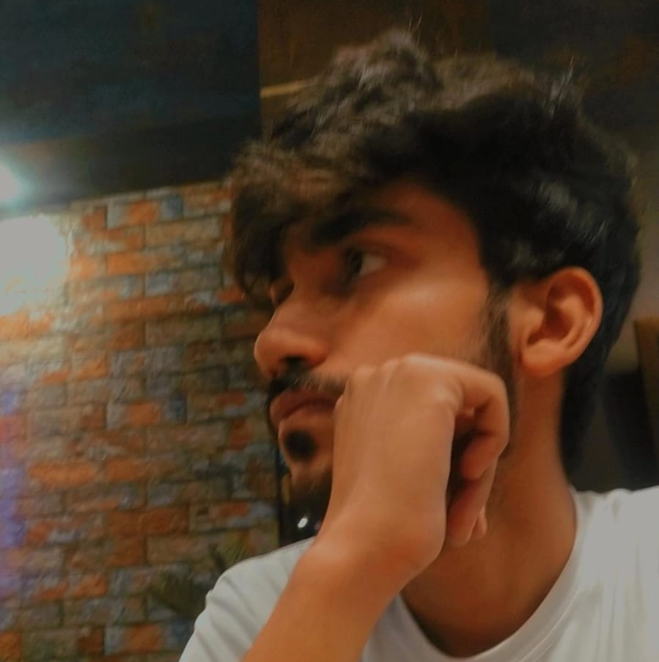
Our Team
Abhinaw Ratan
Satyam
Kumar
Utkarsh
Mathur
201B380
201B244
201B294

Slide 4


Table of contents
01
Our Problem Statement
02
Our Solution
03
04
Expected Outcomes
Tech Stack

Slide 5
Introduction
MyFAANG is a web application that provides users with an immersive mock interview experience using AI-powered Natural Language Processing.
The app uses GPT-3, a powerful language model developed by OpenAI, to generate human-like responses to user questions and simulate a real interview scenario.

Slide 6
01
Our Problem Statement

Slide 7
Many job seekers lack interview practice and feedback, while employers struggle to identify qualified candidates and reduce hiring biases.
There is a need for a web application that can provide users with a personalized and realistic mock interview experience while leveraging AI technology

Slide 8
02
Our Solution

Slide 9
MyFAANG provides users with a web-based platform that leverages AI-powered natural language processing to simulate a realistic interview experience.
Users can choose from a wide range of industries and job roles, and MyFAANG tailors its questions and feedback to each user's background and preferences.

Slide 10
Our Approach
Design and Architecture: We will design a user-friendly web-based platform that leverages AI-powered natural language processing to offer a realistic and customizable mock interview experience.
AI Integration: We will integrate GPT-3 to generate human-like responses to user questions and simulate a real interview scenario.
Testing and Optimization: We will conduct extensive testing to ensure the platform's functionality, usability, and security.

Slide 11
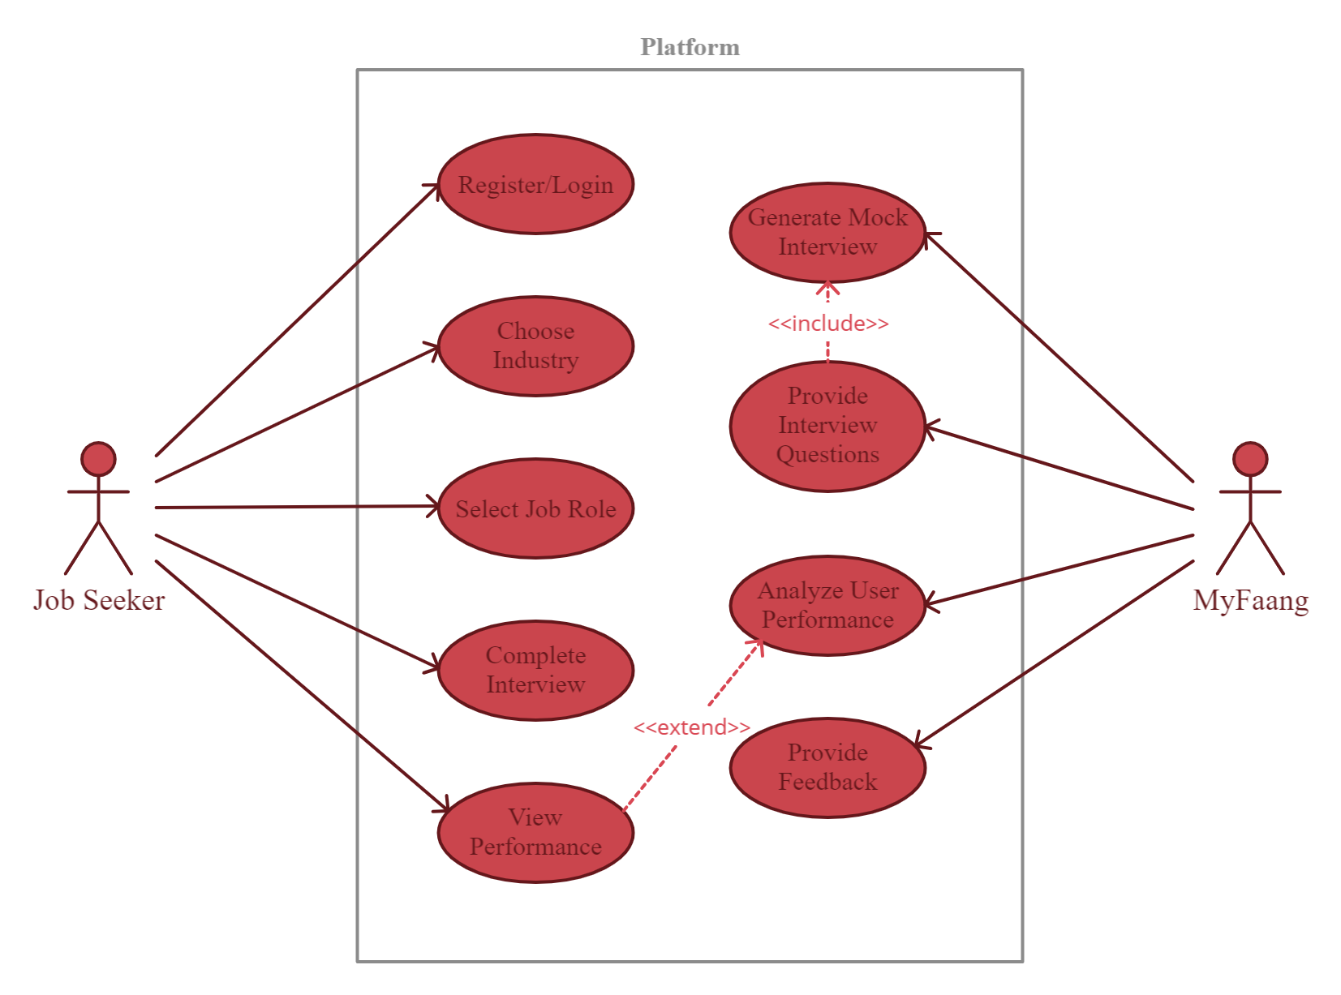
Use Case Diagram

Slide 12
03
Tech Stack

Slide 13


Tech Stack-Frontend
React.js
Tailwind CSS
We are using react framework to develop our frontend application
We will be integrating tailwind css to make our app modern and dynamic

Slide 14
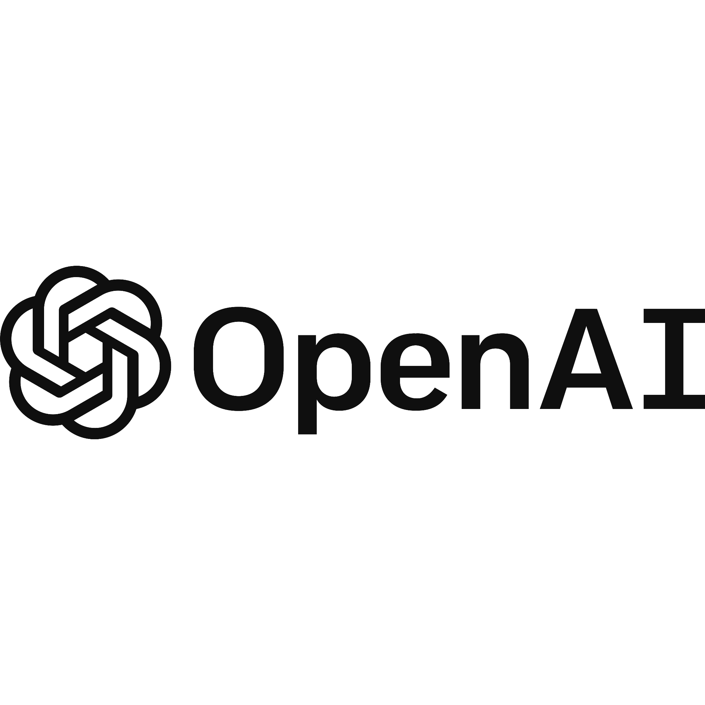


Tech Stack-Backend
Gpt-3 API
Python
Python
Flask
We will be using Gpt-3 API to generate real time humanlike interview interaction
We will be using Python as our programming language to develop the logics
We will be using Python as our programming language to develop the logics
We will be using Python as our programming language to develop the logics

Slide 15
04
Expected Outcomes

Slide 16
Increased knowledge of AI technologies such as GPT-3 and Natural Language Processing
Improved interview skills for job seekers
Experience in project management and team collaboration.
01
02
03

Slide 17
Our Timeline
Devising a Solution
Presenting our platform
P1
P2
P3
Writing the code
..and testing the integrity of our app.

Slide 18




Thanks!
Abhinaw Ratan
Satyam
Kumar
Utkarsh
Mathur
201B244
201B380
201B294

